Slide 1
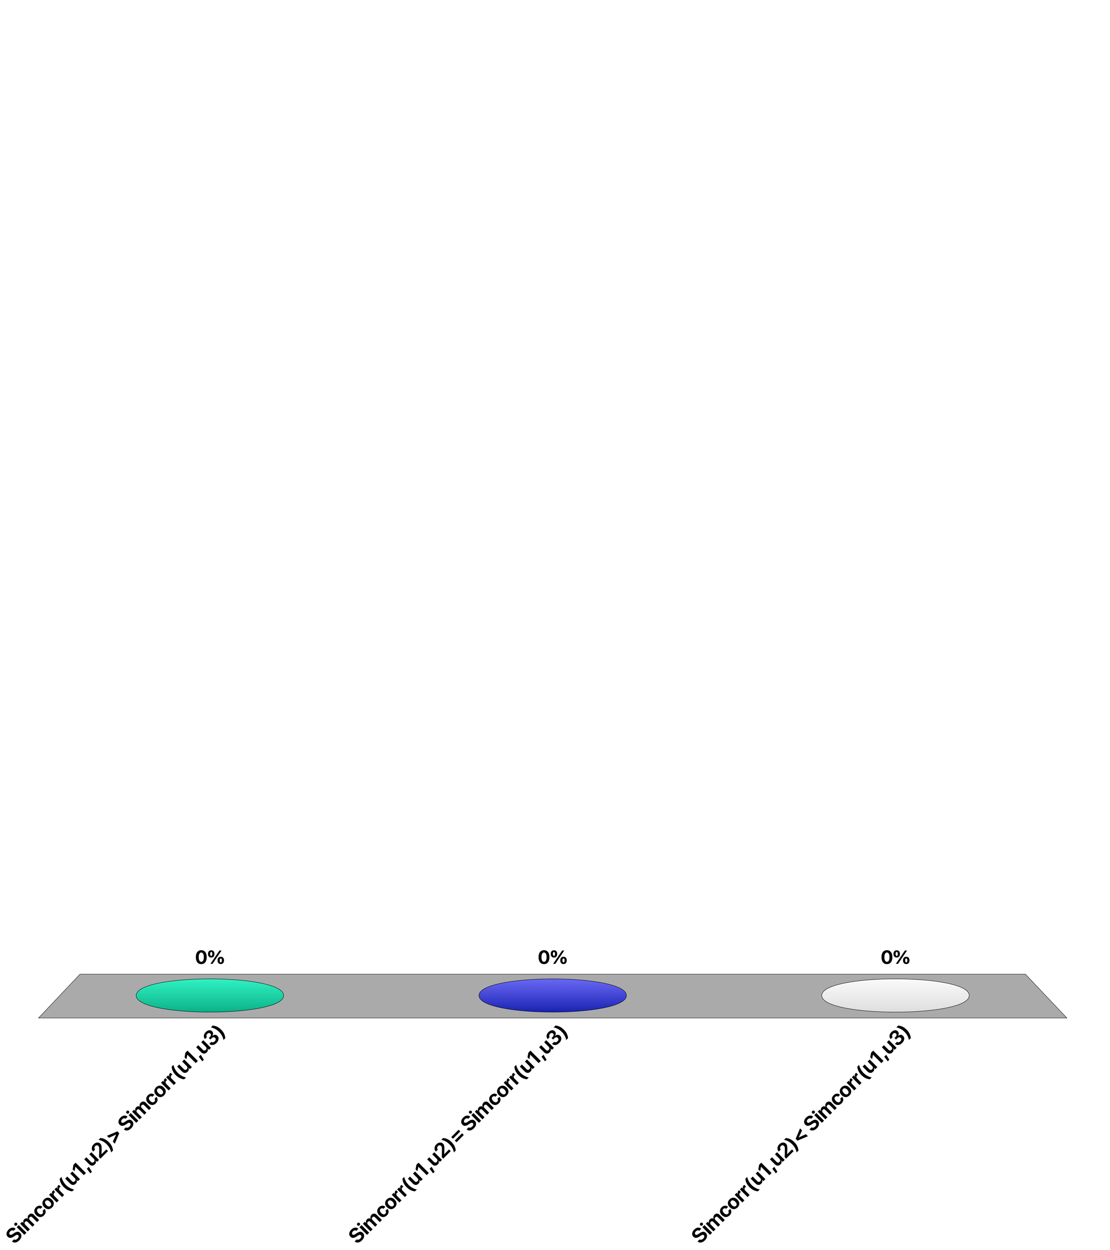
Given 3 users with ratings…
u1: 1 3
u2: 2 4
u3: 1 4
Sim_{corr}(u1, u2) > Sim_{corr}(u1, u3)
Sim_{corr}(u1, u2) = Sim_{corr}(u1, u3)
Sim_{corr}(u1, u2) < Sim_{corr}(u1, u3)
Notes:
Answer B
With Pearson correlation, similarity is computed using vectors that are centered around the mean and the normalized. Therefore, after normalization all three vectors are the same, namely 1/sqrt(2) * (-1,1).

Slide 2
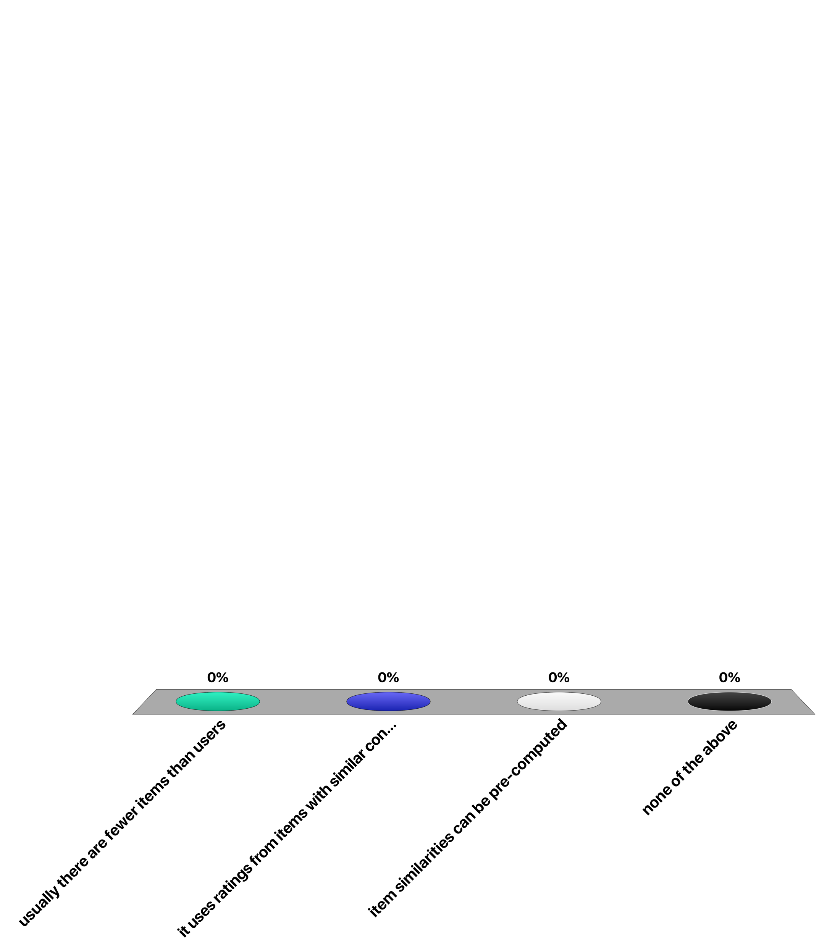
Item-based collaborative filtering addresses better the cold-start problem because …
usually there are fewer items than users
it uses ratings from items with similar content
item similarities can be pre-computed
none of the above
Notes:
Answer D
If a user has no ratings, also item-based collaborative filtering cannot make a prediction on the user’s rating of an unknown item.
If the item in question has not ratings, not similar items can be determined and no predication can be made as well.

Slide 3
For a user that has not done any ratings, which method can make a prediction?
User-based collaborative RS
Item-based collaborative RS
Content-based RS
None of the above
Notes:
Answer D
User-base and item-based collaborative filtering cannot make predictions without previous ratings of the users.
Since the user has not rated any item, also content-based filtering is not applicable.

Slide 4
For an item that has not received any ratings, which method can make a prediction?
User-based collaborative RS
Item-based collaborative RS
Content-based RS
None of the above
Notes:
Answer C
Based on the content, similat items can be found, even if the item has not yet received a rating.

Slide 5
Question
How does matrix factorization address the issue of missing ratings?
It uses regularization of the rating matrix
It performs gradient descent only for existing ratings
It sets missing ratings to zero
It maps ratings into a lower-dimensional space
Notes:
Answer B
In gradient descent only data on existing ratings (user-item pairs) are exploited.

Slide 6
Question
With matrix factorization one estimates ratings of unrated items
By retrieving the corresponding item from a user vector
By retrieving the corresponding item from an item vector
By computing the product of a user and an item vector
By looking up the rating in an approximation of the original rating matrix
Notes:
Answer C
For estimating a new rating the latent representations of the corresponding user and item are used to compute an estimation. In principle, one could also consider Answer D as correct, but this would imply that all ratings are precomputed, which would be a waste of resources, if only few ratings need to be known.

Slide 7
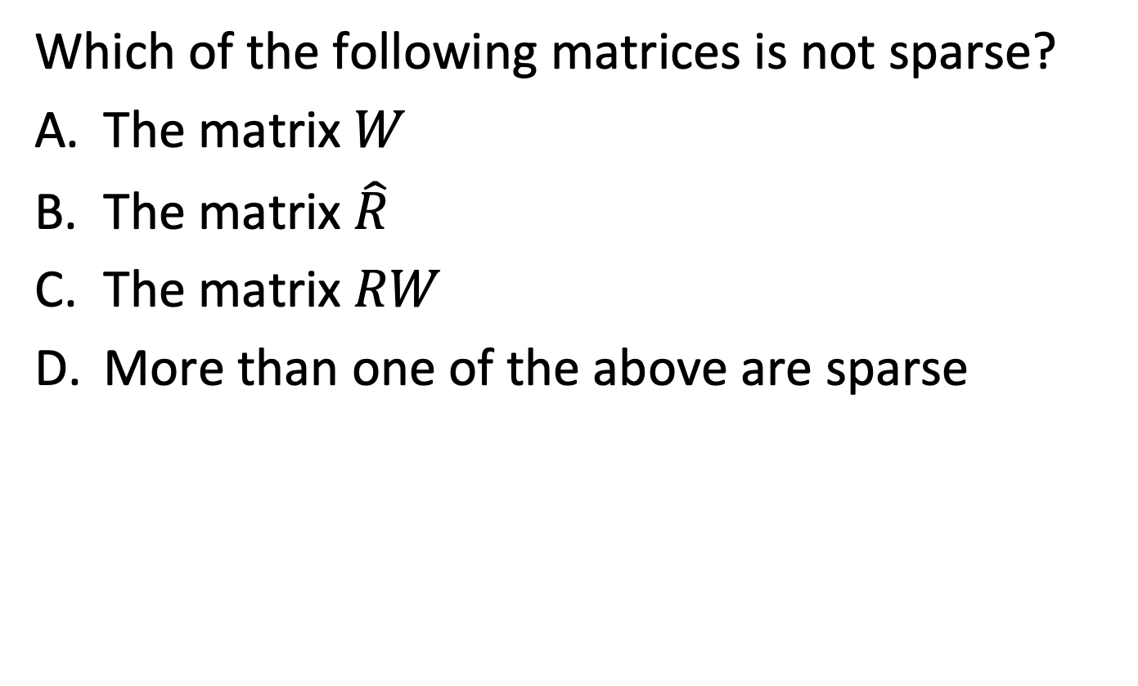
Question
Which of the following matrices is not sparse?
The matrix $W$
The matrix $\hat{R}$
The matrix $RW$
More than one of the above are sparse
Notes:
Answer A
Only the matrix W is sparse. The two other matrices are the same, and contain rating estimations for all items. Therefore, they are not sparse.

Slide 8
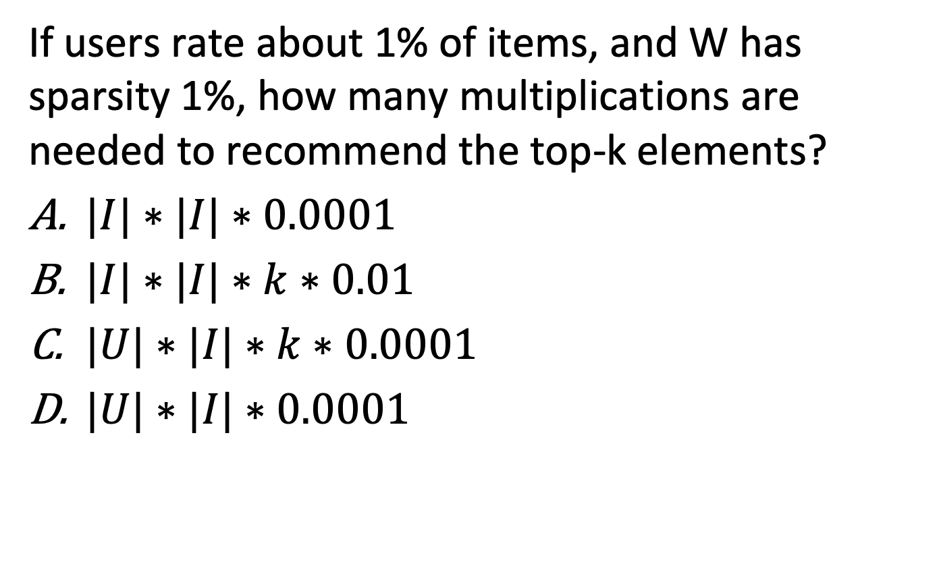
Question
If users rate about 1% of items, and W has sparsity 1%, how many multiplications are needed to recommend the top-k elements?
$|I|∗|I|∗0.0001$
$|I|∗|I|∗k∗0.01$
$|U|∗|I|∗k∗0.0001$
$|U|∗|I|∗0.0001$
Notes:
Answer A
For finding the top k ratings, for each non-rated item of the user (about |I|), the rating vector of the user has to be multiplied with the corresponding item vector in W. The user rating vector has about |I| * 0.01 non-zero entries, as well as the item vector. Computing the scalar product of a dense vector takes |I| multiplictaions. Therefore, in total |I|^2 * 0.00001 multiplications will be performed.

Slide 9
Question
Assume in top-1 retrieval recommendation 1 is (2, 3, 1) and recommendation 2 is (2, 1, 3)
RMSE(rec 1) < RMSE(rec 2) and DCG(rec 1) > DCG(rec 2)
RMSE(rec 1) = RMSE(rec 2) and DCG(rec 1) > DCG(rec 2)
RMSE(rec 1) < RMSE(rec 2) and DCG(rec 1) = DCG(rec 2)
RMSE(rec 1) = RMSE(rec 2) and DCG(rec 1) = DCG(rec 2)
Remark: the optimal method would rank (3,2,1)
Notes:
Answer C
Since DCG considers only the top-k items, in this case the first item, the measure is independent of the ordering of the non top-k items. RMSE will give a better score to rec 1, since the higher rated item 3 is ranked higher in the result.

